Slide 1
Transition Status Report
IBM INDIA
21Mar2017
Prepared for Heineken International B.V.

Slide 2
HEINEKEN AMS Support Transition Timelines
Transition approach by IBM
Oct, 2016
Prepared by :albert.veldhoven@nl.ibm.com

Slide 3
Transition Planning Approach
GP can start ideally after UAT has been finalized
GP needs to be finalized (1 week) before Toll gate meeting for the release
IBM will move to AP the moment the software has been moved to Production.
Only after Business Go live the transition will proceed as of that time only the software will be used and at least 2 weeks of AP
Steady
State
UAT
Toll gate
Release
Technical
Go live
Release
Business
Go live
Go / No
Go call
to AP
Go / No
Go call
to PP
Go / No
Go call
to SS
GP
AP
PP

Slide 4
Overall Transition Status
 | In Flight | Vendor Managed | New App
Total Projects | 205 | 6 | 31
Formally Closed | 176 | 5 | 25
Current WIP Projects | 26 | 1 | 5
Intake to be done + Hold + No Pursuit | 3 | 0 | 1
Projects Closed during the month
Jan-16 | Feb-16 | Mar-16 | Apr-16 | May-16 | June-16 | Jul-16 | Aug-16 | Sep-16 | Oct-16 | Nov-16 | Dec-16
6 | 3 | 12 | 7 | 15 | 2 | 10 | 11 | 4 | 10 | 2 | 9
In Flight
New Apps
Jan-16 | Feb-16 | Mar-16 | Apr-16 | May-16 | June-16 | Jul-16 | Aug-16 | Sep-16 | Oct-16 | Nov-16 | Dec-16
 |  | 2 | 1 | 5 | 1 | 2 | 1 |  | 7 | 2 | 1

Slide 5
Transition Master Plan

Slide 6
Content
Inflight Projects

Slide 7
Inflight Project(s) – Harish / Benjamin
HeiXS – Interfaces Logistic Process
PP Phase Go/NoGo – To be planned.
C&TP Flight Enhancements (Mar-17)
AP Phase – In Progress as planned from 20Mar.
C&TP Flight Enhancements (Apr-17) - 1 CR (CHG0153146). Go Live on 23Apr.
AP Phase from 24Apr. KT Session completed.

Slide 8
Inflight Project(s) – Harish / Edger de Mots
FSCM - Enhancement - CHG0154357 (Feb release)
SS Phase : In Progress. Hand over to AMS Support
FSCM - Enhancement (Apr release)
GP Phase : From 27Mar – Planned. KT session scheduled
Apr release :
CHG0157790 : Part 3 - FSCM : DCD Search Result Fields
CHG0157789 : Part 3 – ECC : DCD Search Result Fields
CHG0154356 : Part 2 – ECC : Customer Statement
CHG0161765 : Part 4 - FSCM : Dispute ; add attachment & Improve Mail

Slide 9
Inflight Project(s) – Harish / ??
Sourcing – 3 CR’s (CHG0160919, CHG0160918, CHG0160915 - Apr Release)
ASP Phase : In Progress
GP Phase : Agreed. Planned from 27Mar for 3 CR’s planned for Apr.
CHG0160919 : Project Field Enhancements v2
CHG0160918 : 05. BRD CSP Document Type creation
CHG0160915 : 01.BRD - Approval - Phase - Clicks reduction v2

Slide 10
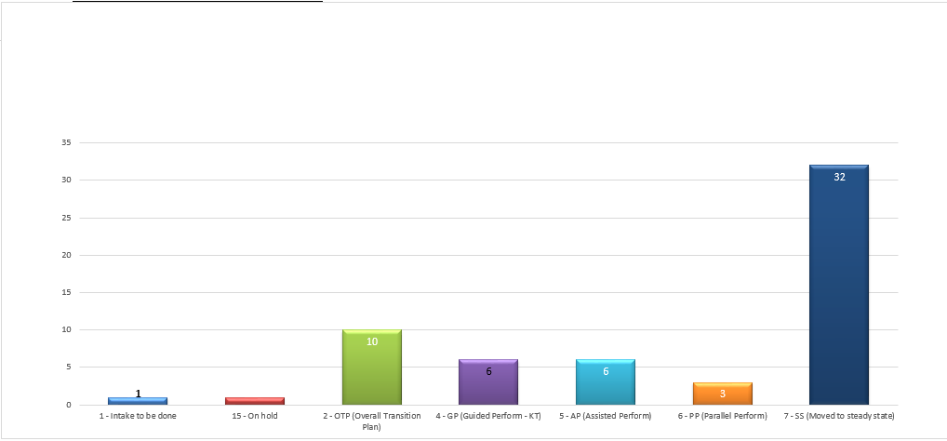
Overall View of Inflight Projects – 21-Mar

Slide 11
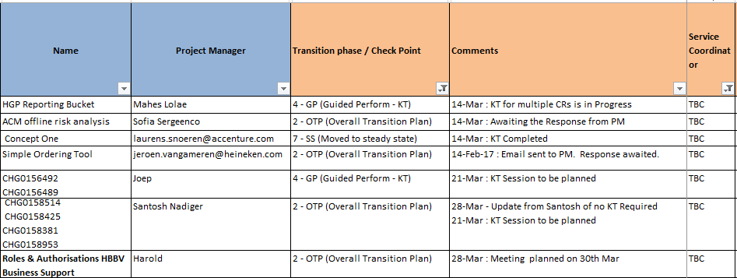
New Projects / Change Requests Added [Details to be obtained]

Slide 12
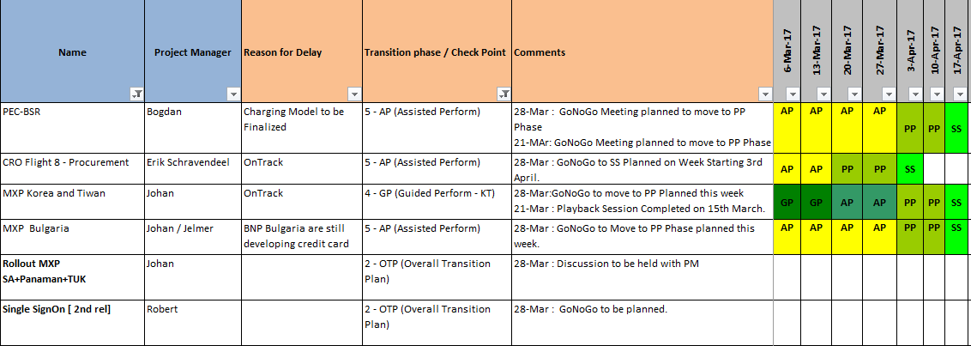
Inflight Project(s) view under Sharon

Slide 13
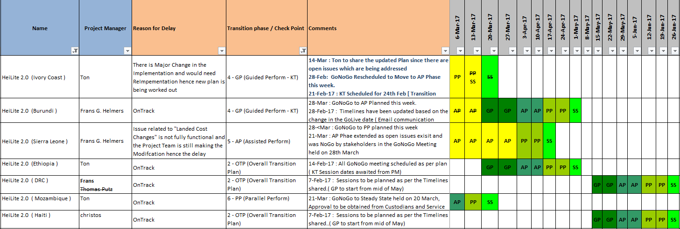
Heilite 2.0 - Plan on Page for All the new Opcos

Slide 14
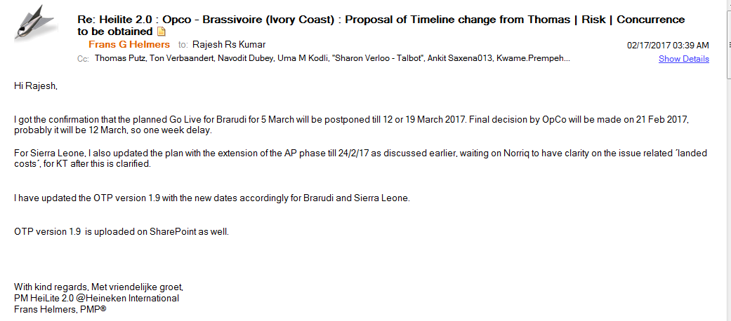
Heilite 2.0 (Brarudi) GoLive Delayed, plan updated accordingly.
Heilite 2.0 (Ivory Coast) – To be Replanned - Update Awaited from Ton,
Heilite 2.0 ( Ethiopia) – Updated Plan to be obtained from Ton

Slide 15
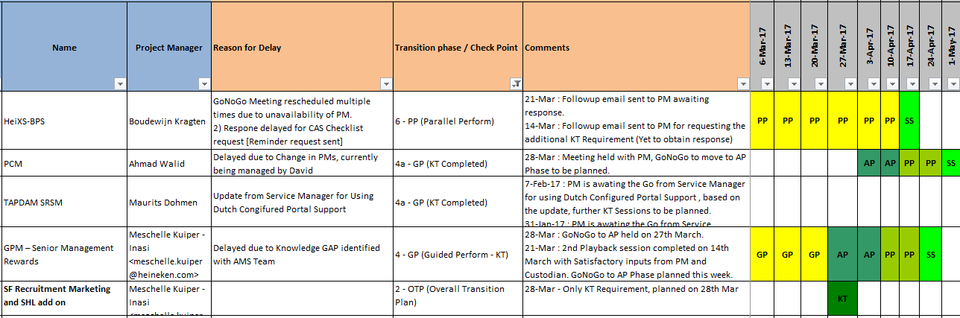
Inflight Project(s) view under Benjamin

Slide 16
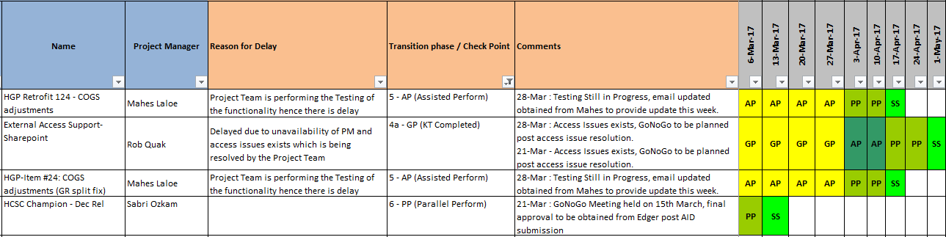
Project(s) view under Edger de Mots

Slide 17
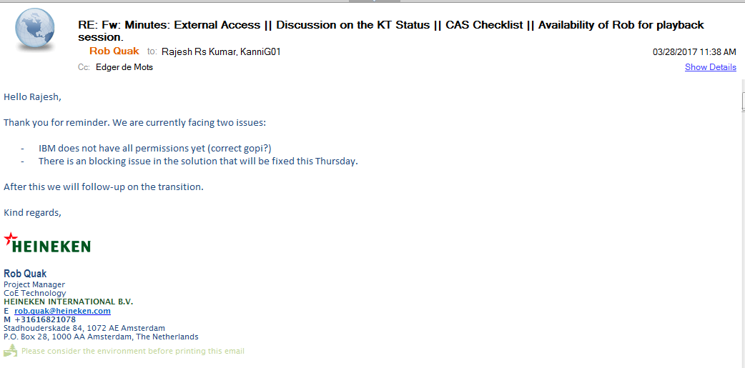
Update on External Access Sharepoint

Slide 18
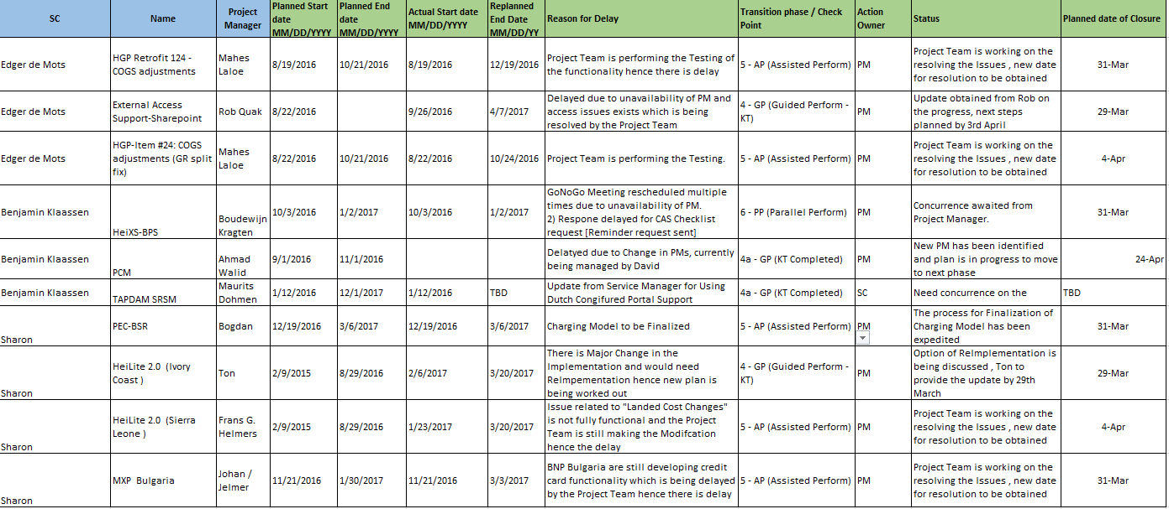
Summary of the Inflight projects with Reasons for Delay ( Under review by Service Coordinators)

